Slide 1


Predicting and Preventing Customer Churn in Banking Using Deep Learning
Leveraging neural networks and explainable metrics to identify churn risk and craft high-impact retention strategies.
This project is based on a publicly available dataset from Kaggle and serves as a real-world simulation for predictive modeling and business strategy.

Slide 2
Key Highlights:
Achieved 86% accuracy using a custom neural network model.
High precision (87%) for non-churners; focused strategies needed for churners.
Identified churn patterns via model interpretation and EDA: age, geography, product count, activity.
Delivered professional-grade HTML dashboard, analytics summary, and live insights.
Business case: Up to 15x ROI by targeting high-risk, low-engagement customers.

Slide 3
Problem:
Customer churn is directly linked to lifetime revenue loss. Reducing churn by just 1% can save the bank over $1.5M/year.
Objective:
Identify which customers are most likely to churn.
Understand why they leave and and build preventive strategies.
Provide business teams with an ML-powered decision toolkit.
Stakeholders:
CMO, Product, Customer Experience, Data Science, CRM Teams.
ARPU of $1,500 is assumed based on conservative industry averages for retail banking customers.

Slide 4



Dataset & Exploration
Dataset Overview:
Churn Rate:
Size: 10,000 customers
Features: 14
Target Variable: Exited (1 = churned, 0 = retained)
Overall: 20.3%
Highest churn rates among:
German customers
Aged 45–60
Inactive users
Customers with low product count

Slide 5
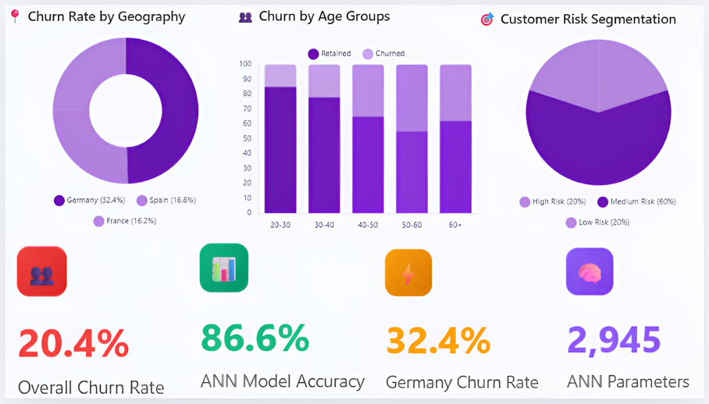
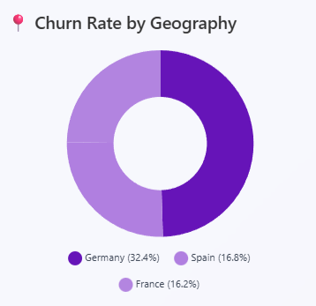
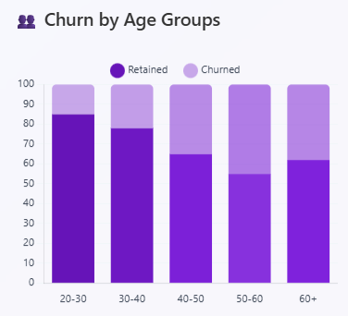
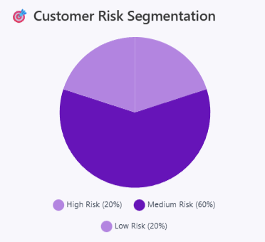

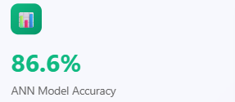
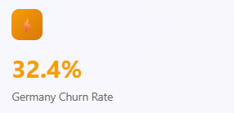
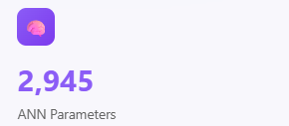

Slide 6
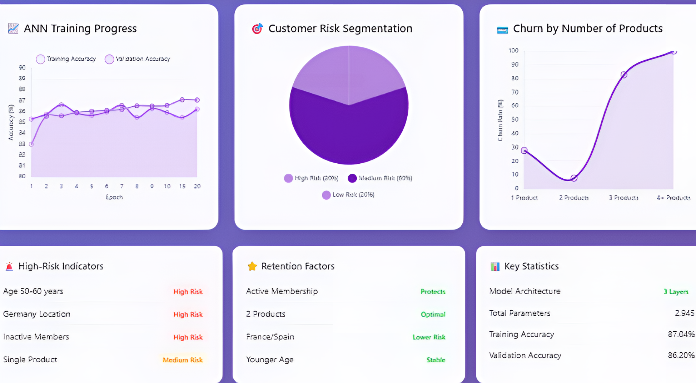

Slide 7
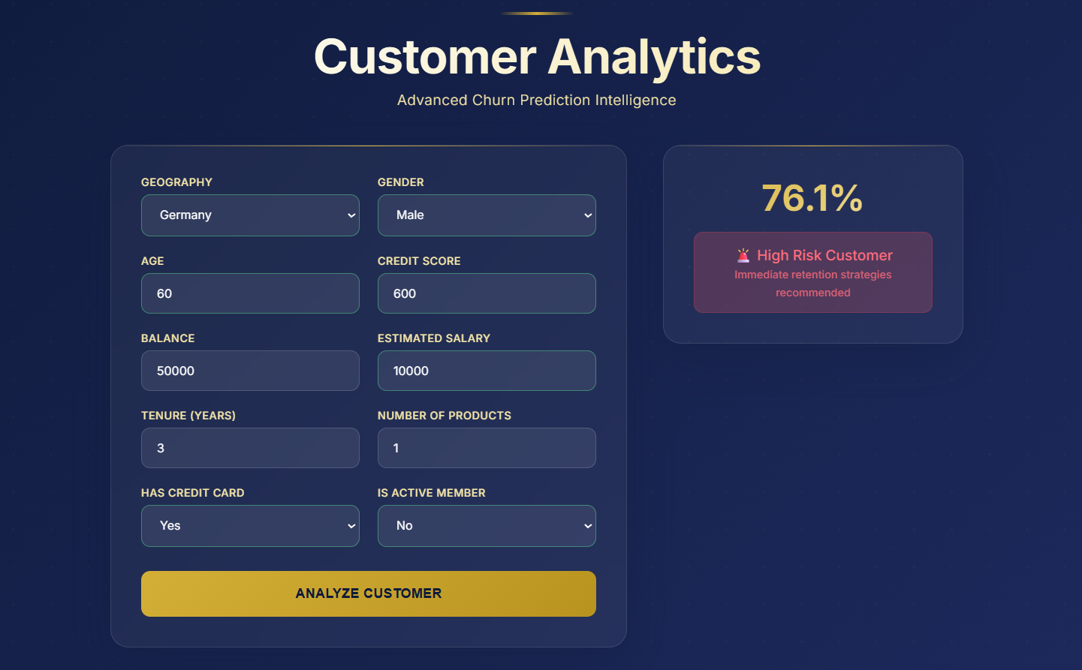

Slide 8
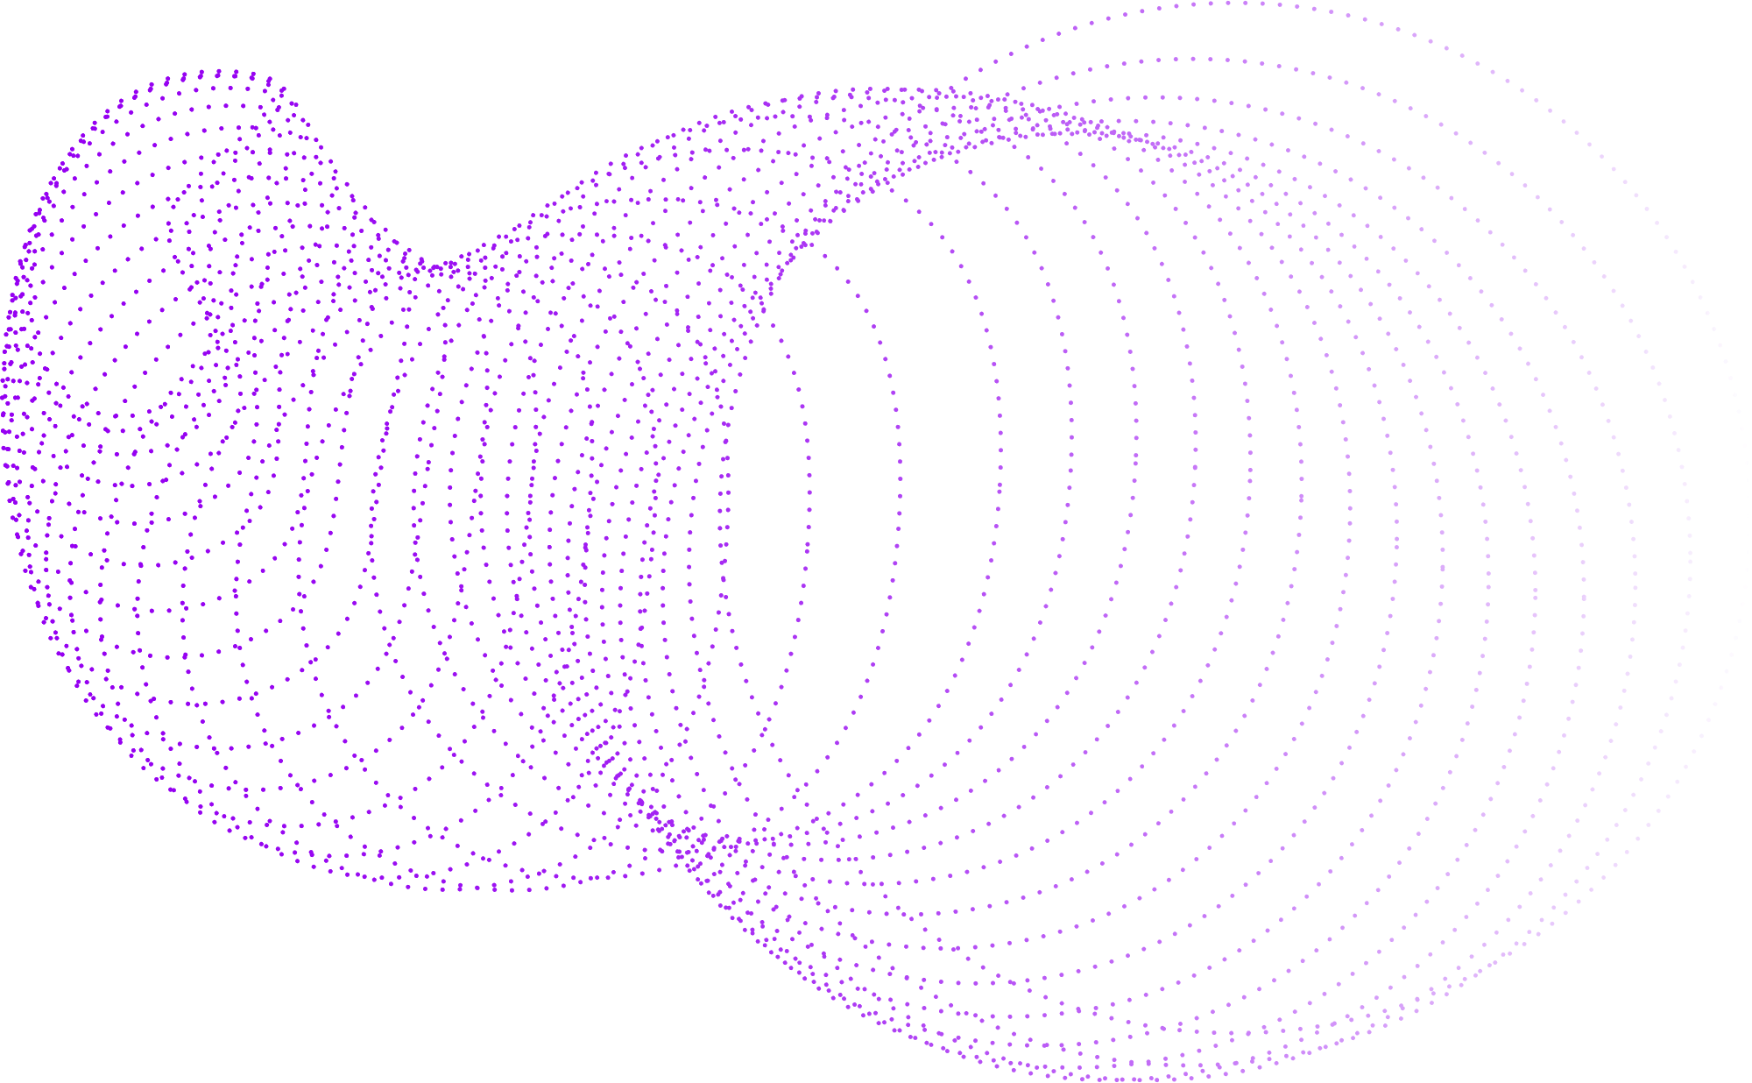
Model Type:
Neural Network | Sequential, 3 Dense Layers
Activations: | ReLU, Sigmoid
Loss Function: | Binary Crossentropy
Optimizer: | Adam
Model Architecture & Training
Training Summary:
Epochs: | 20
Parameters: | 2,945
Training Accuracy: | 87.06%
Validation Accuracy: | 86.20%

Slide 9
Confusion Matrix:
True Negatives: | 1553
False Positives: | 54
False Negatives: | 222
True Positives: | 171
Model Identifies Churned Customers with 76% Precision, 86% Accuracy
Classification Report:
 | Current Year | Target Year
Precision | 87% | 76%
Recall | 97% | 44%
F1 Score | 92% | 55%
Accuracy: 86%
Macro Avg F1: 74%
Weighted Avg F1: 85%

Slide 10


Business Insights from Model
Top Churn Predictors Identified:
Geography (Germany)
Inactivity Score
Age Group: 45+
Low Product Count
Strategic Actions:
Personalized offers for high-risk segments (inactive + German)
Incentivize product bundling for single-product users
Launch re-engagement journeys for silent accounts

Slide 11

Strategic Recommendations to Reduce Customer Churn
High churn probability for customers with long tenure and no recent engagement
Lower support engagement correlates with churn
Launch proactive loyalty campaigns (e.g., special offers or personalized communication) targeting long-tenure inactive user
Proactively engage via automated but personalized support nudges (chatbots, WhatsApp updates)
Tech-savvy customers prefer online support and churn less
Churned customers often show decline in usage weeks before exit
Invest in better self-service portals, FAQs, and AI-based chat assistants
Set up real-time churn alerts using model outputs to trigger retention interventions automatically
BACK TO AGENDA PAGE

Slide 12
Business Impact: Translating Model Accuracy into Value
Key Takeaways:
Potential ROI Scenario:
Future Roadmap:
3% Accuracy gives a highly reliable tool for predicting churn
Precision for Churned Class: 76%
For every 100 customers predicted to churn, ~76 actually will, allowing targeted retention campaigns
Early Identification Window:
With the model deployed weekly/monthly, alerts can be triggered weeks in advance, improving customer lifetime value (CLTV)
If average CLTV per customer = ₹10,000
Predicting and retaining just 100 customers/month →
Annual savings: ₹1.2 Crores
Integrate with CRM systems to trigger real-time alerts
A/B test retention campaigns based on model triggers
Monitor drift and retrain model quarterly

Slide 13
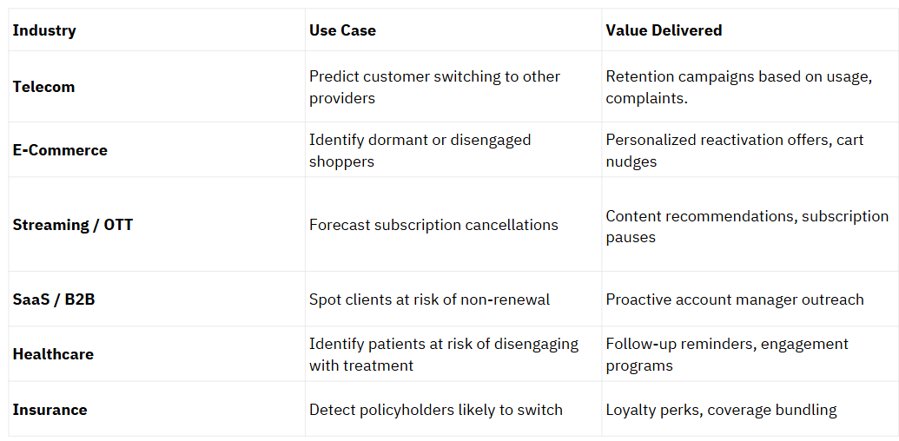
Cross-Industry Applications of Churn Prediction

Slide 14
Research Sources & Industry References
1. Banking & Churn Insights
McKinsey & Company (2023). “Rewriting the Rules in Retail Banking”
Bain & Company (2022). “Customer Loyalty in Retail Banking”
Harvard Business Review. “The Value of Keeping the Right Customers”
2. Machine Learning Modeling
Kaggle Dataset: Customer Churn in Banking
Google Cloud ML Whitepapers: Modeling Churn & Class Imbalance
3. ANN & Classification Metrics
TensorFlow/Keras Docs: Neural Network Training & Architecture
Scikit-learn Docs: Precision, Recall, F1 Score Definitions
Towards Data Science (Medium): “Predicting Churn with Neural Nets”
4. Dashboard & Data Storytelling
McKinsey Data Visualization Style (internal standards)
Chart.js & D3 Documentation
5. Industry-Level Data Science Portfolios
LinkedIn & GitHub Best Practices for AI Portfolio Building

Slide 15
THANK YOU
Looking forward to discussing how these insights can drive real business impact.
Shubek Sidhu
Analytical Problem Solving | Predictive Modeling | Business Value Realization
shubeksidhu1@gmail.com

